Slide 1
Restaurant Visitor Forecasting
B565 - DATA MINING FALL’21 - PROFESSOR YUZHEN YE
SHRIYA MANDARAPU
KARTHIK SHATHIRI

Slide 2
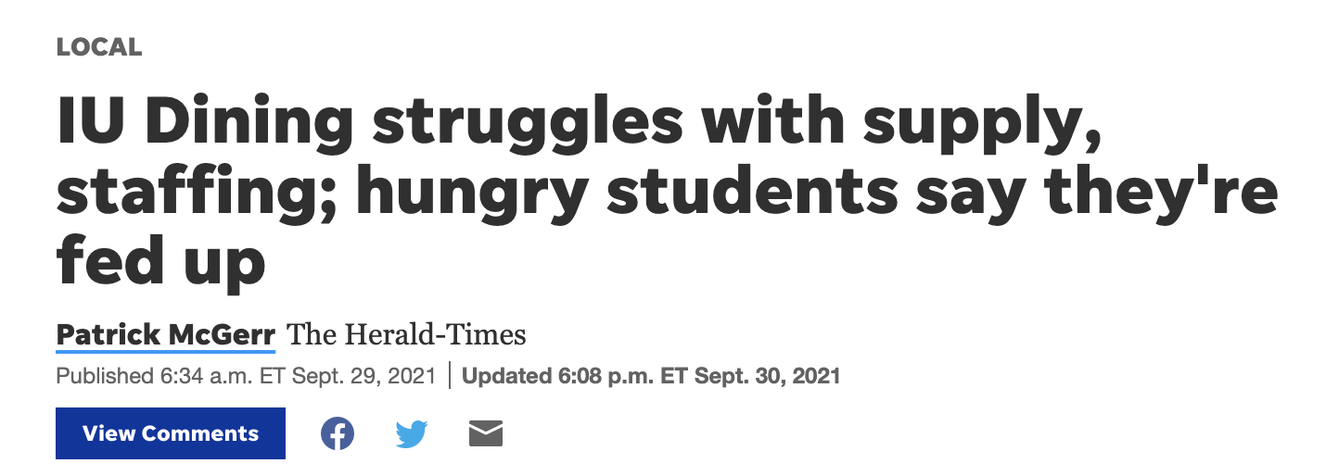


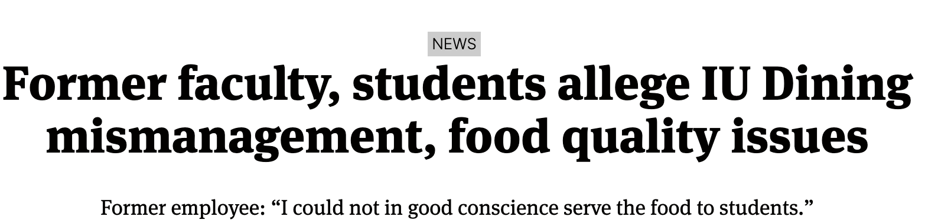
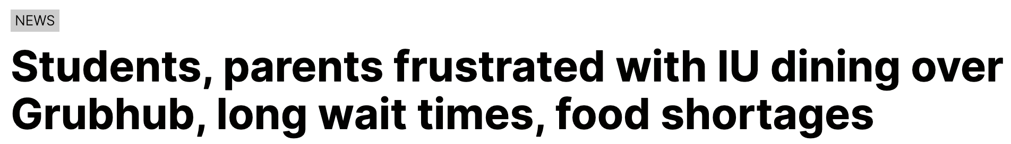
Motivation

Slide 3

SOLUTION
DEMAND FORECAST
Staff Management
Quality Service
Food Wastage
PROBLEM
DOMAINS
Meal Plan Scheduling
Inventory Management
Notes:
There are multiple underlying issues here. Due to no proper tracking

Slide 4




Class schedule dependency
Food wasted in the Inventory
Quality Service
FOOD
Food wasted due to excess
Food wasted in left overs
Menu Engineering
Plate portioning
Utilization of WorkForce
Counter dependencies
Holiday effect

Slide 5
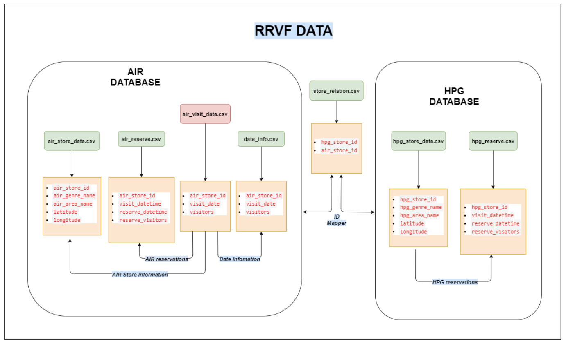

Hotel Sales Forecasting Data
Notes:
Source of data: recruit restaurant forecasting kaggle comp.
data from jap restaurants.
data source - kaggle comp
data is at daily aggregate in this case.
our source - pos transaction
We can have it for each meal of the day(Mcnutt)

Slide 6
WorkFlow
01
Data Preprocessing - Merging & Cleaning
Merging multiple datasets
Null values - (Prophet robust to missing dates)
Outliers
02
Exploratory Data Analysis
Data Visualization (Weekly, Daily, Yearly Trends)
Visualize holiday effect
Reservations vs Actual Visitors
03
Feature Engineering & Feature addition
Weather data integration
Time gap between reservation and actual visit times
Day-of-week, Day-of-month, pre & post holiday attributes
04
Modeling
Time Series Approach - Existing models + Prophet
Regression Approach - Adaboost, XGBoost
05
Evaluation Metric Selection
RMSE vs RMSLE
06
Insights & Summarize
Model Evaluation - Why & Which works best?
Take Away
Future Scope

Slide 7
Hotel Base
Reservation Systems
EDA
Customer Behavior
Hotel Cuisines

Slide 8
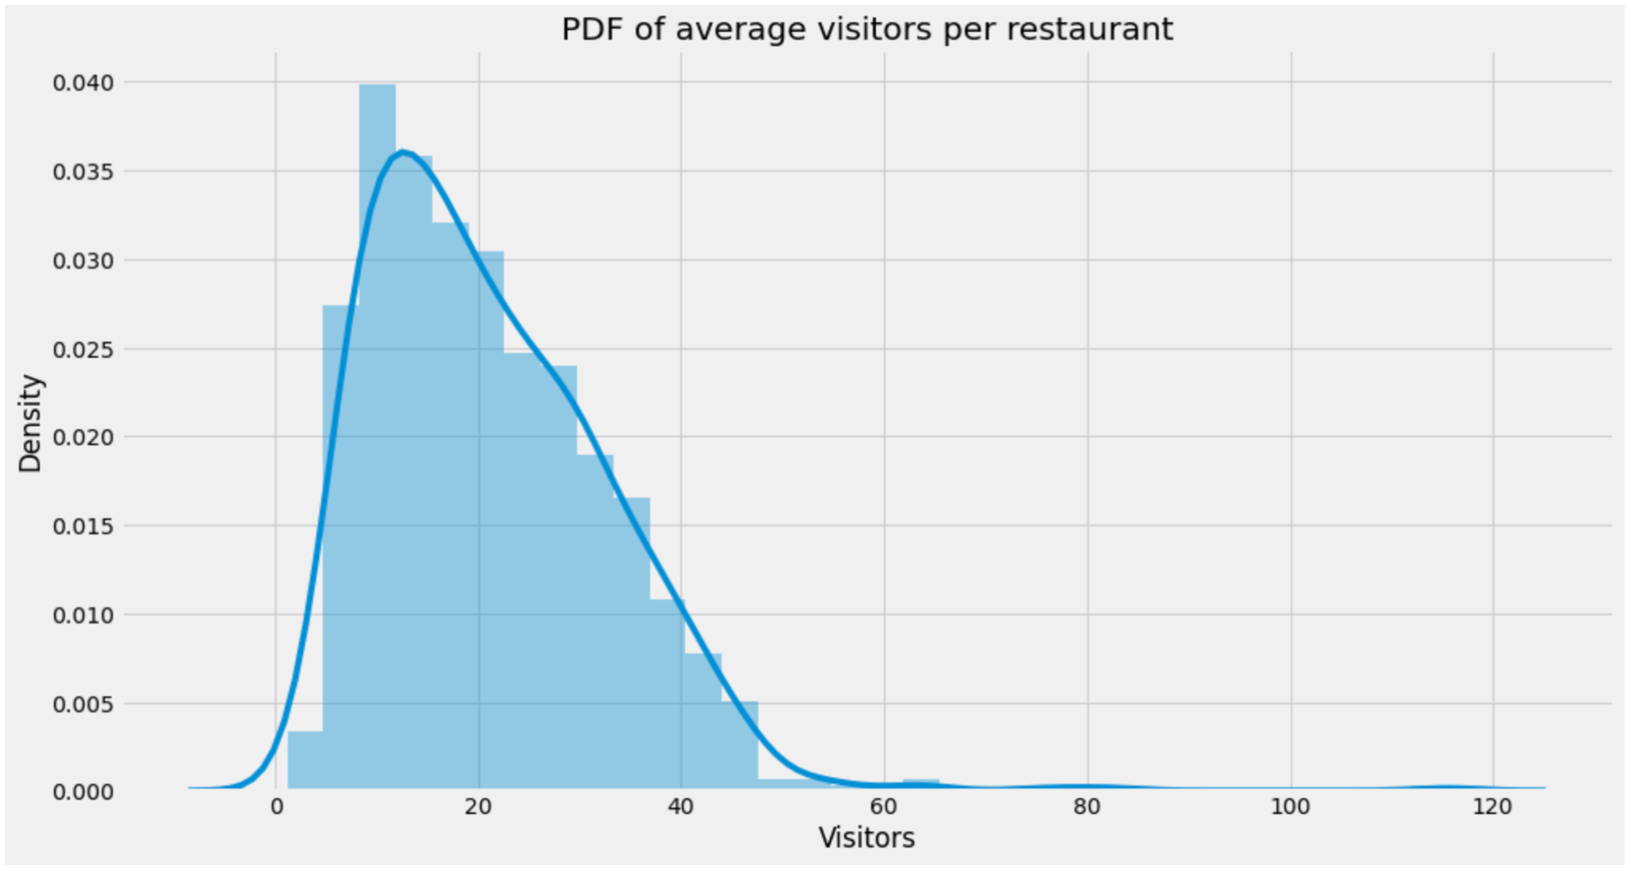
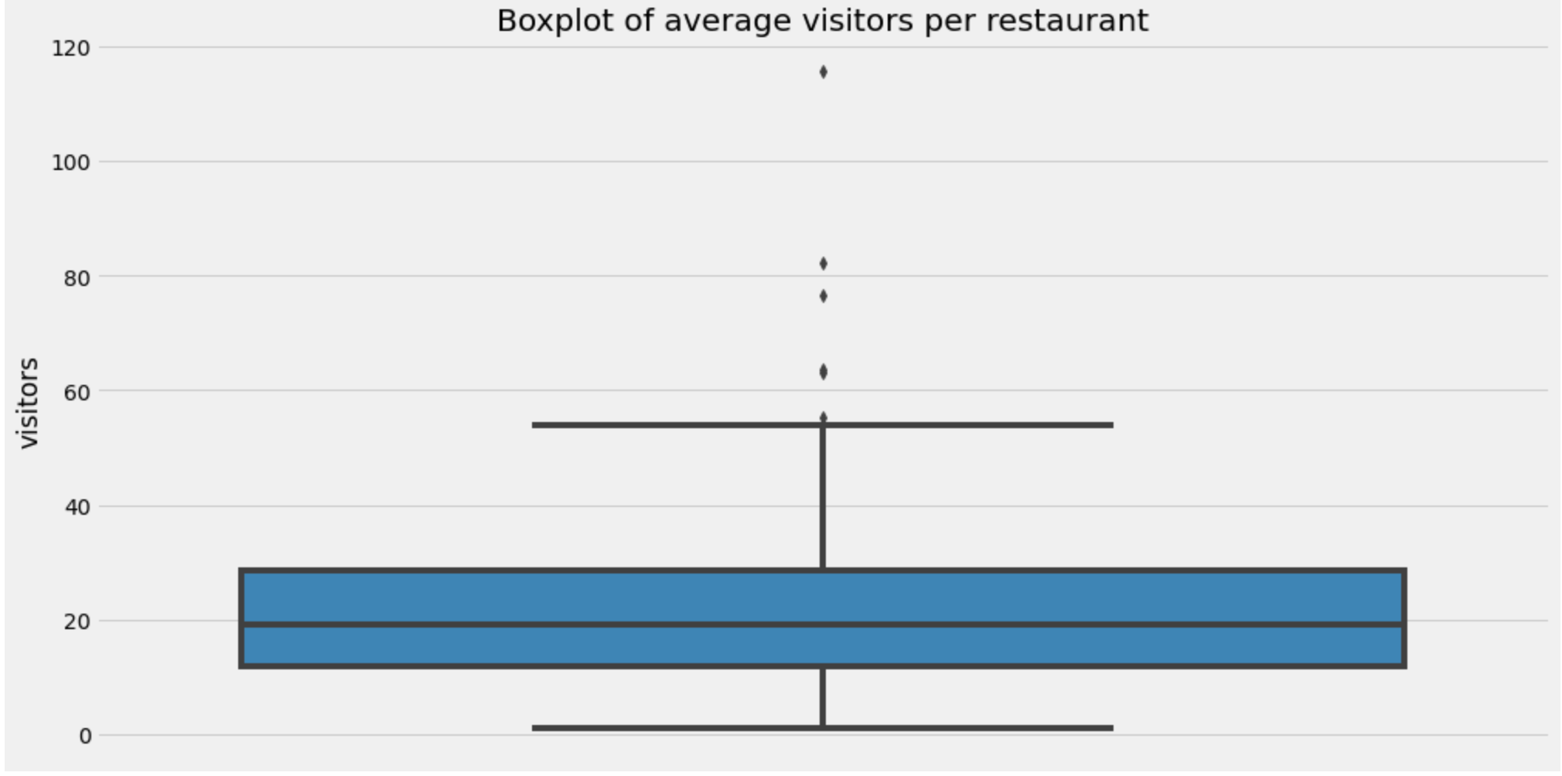
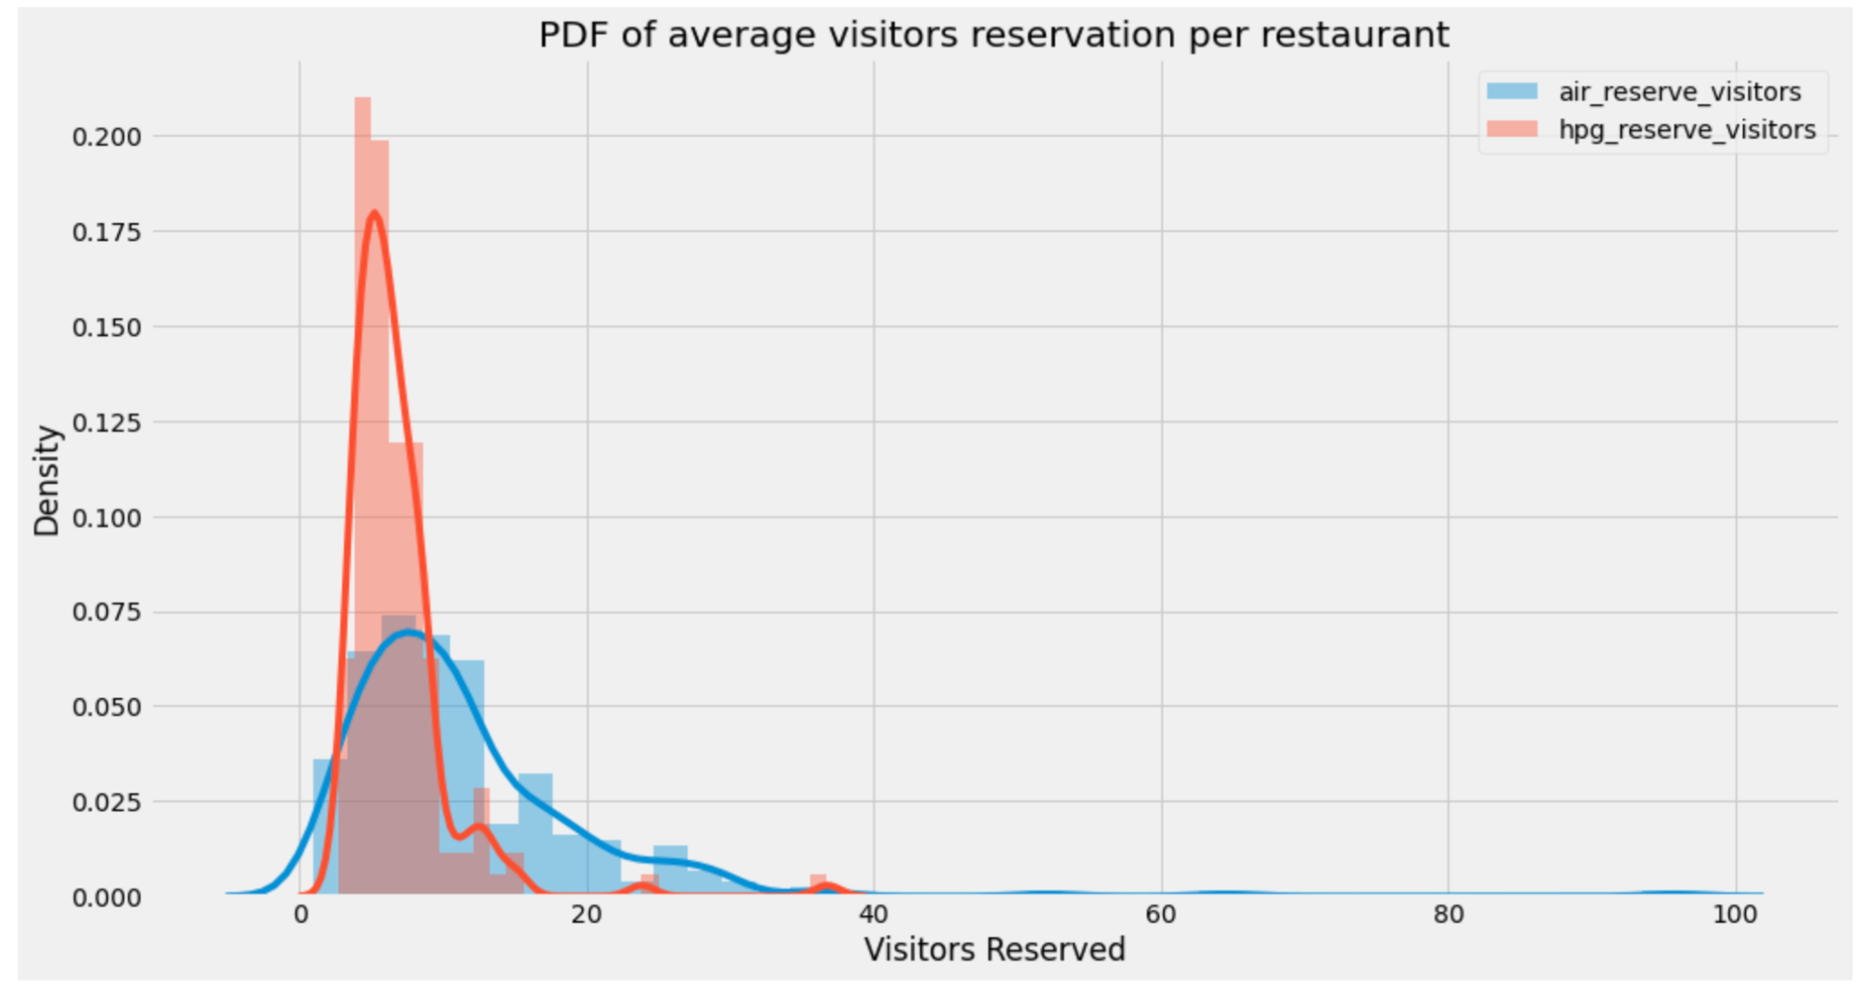
EDA - Hotel & Reservation Systems
Almost 90% of them have less than 40 visitors a day
Most of the hotels have a capacity around 20 (Small Hotels)
The number of unregistered visitors is far more than the number of registered visitors.
In Hpg - Last few hours before the visit don’t see more volume than the 24 or 48 hours before. This is in stark contrast to the air data.

Slide 9
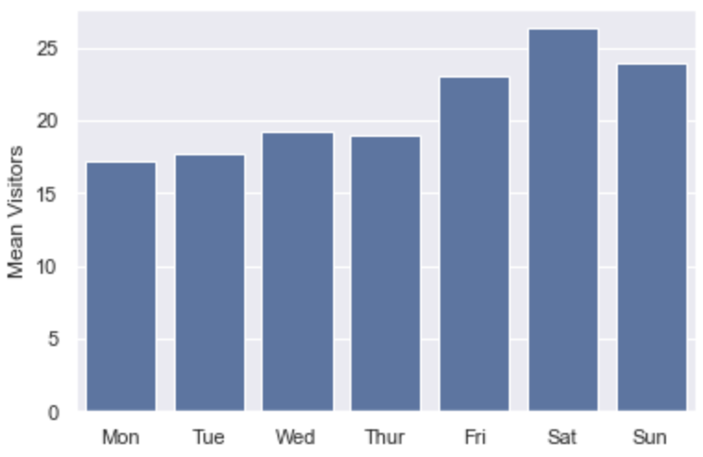
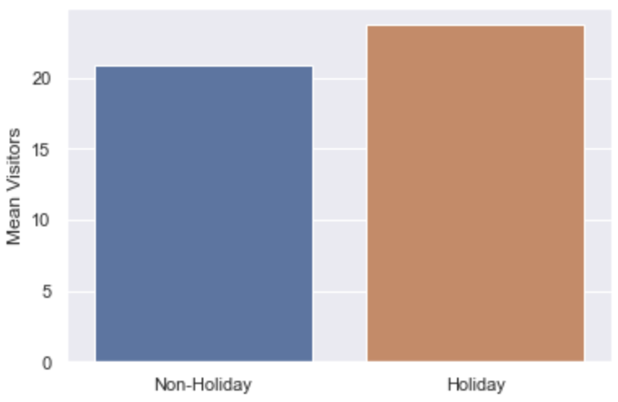
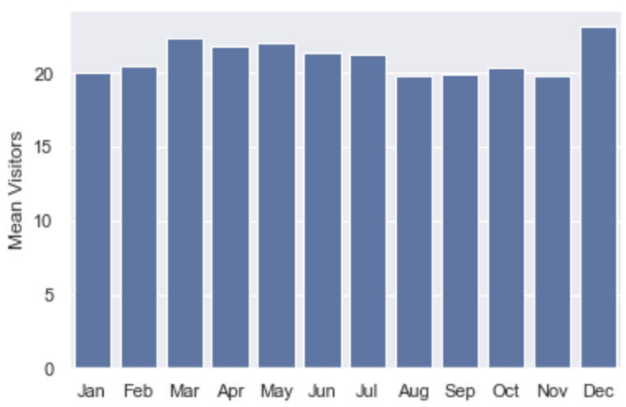
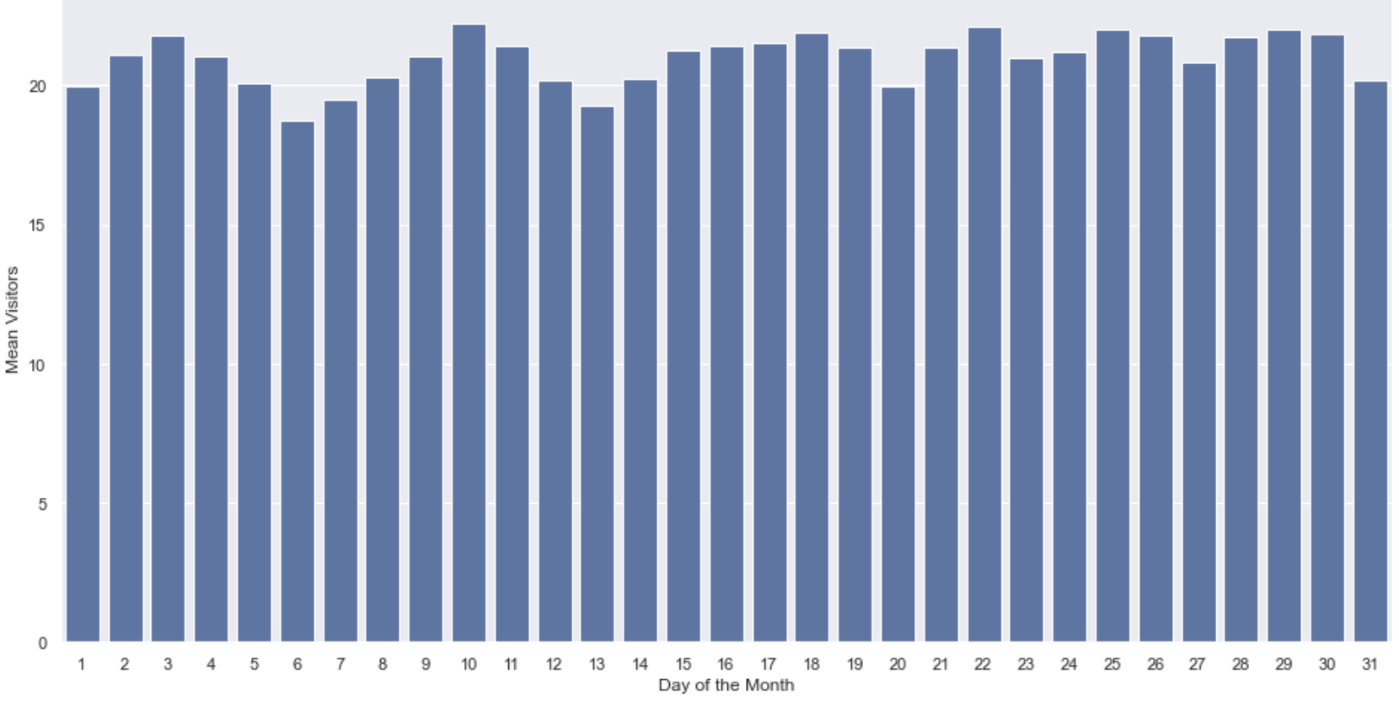
EDA - Behavior & Trend
Japanese culture!
Holidays had higher visitors. This isn’t significant though!
Saturdays are busier than sundays!
There is a clear weekend effect and not so significant holiday effect. Spikes on holidays that fall on weekends, can be fairly attributed to being a weekend.
December is a festive month which explains the peak.

Slide 10
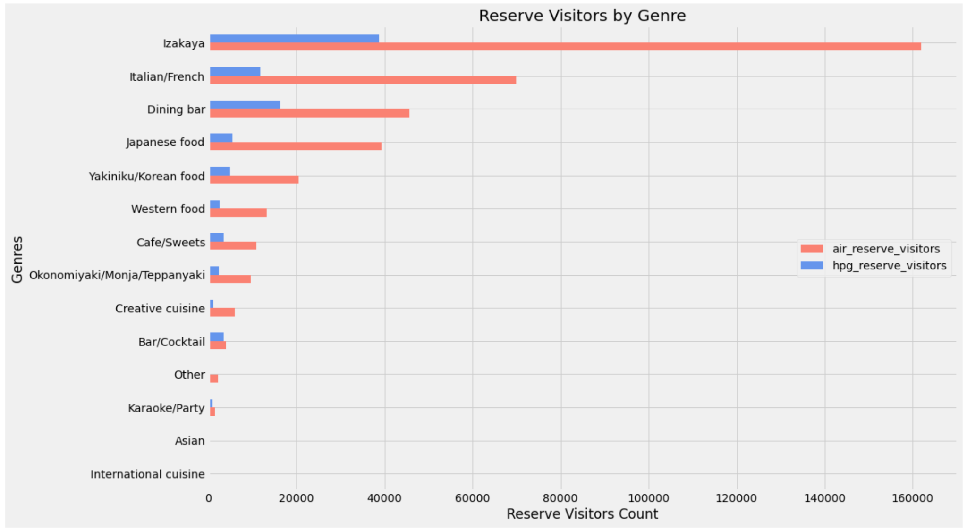
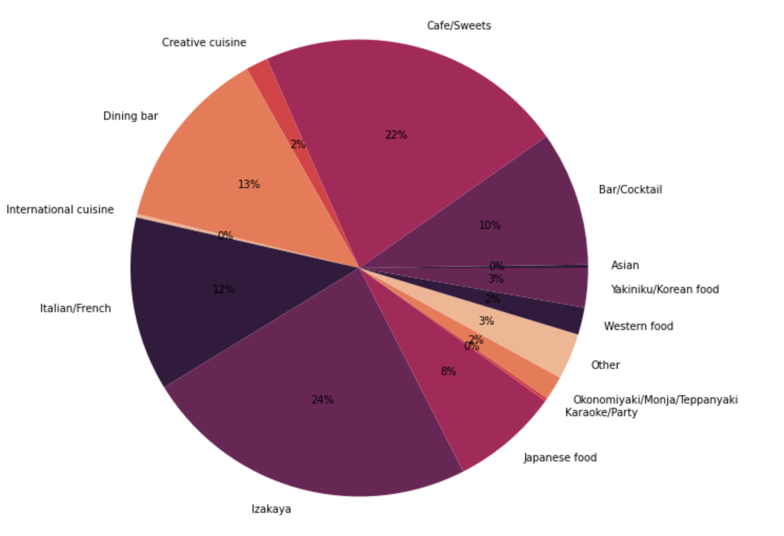
EDA - Cuisine
The restaurants in Japan is subdivided in 14 cuisines.
Izakaya is the most popular cuisine in Japan as almost 23.8% of restaurants are of Izakaya
The biggest difference between weekend and weekdays exists for the “Karaoke” bars, weekends are high - Similar trend for International.

Slide 11
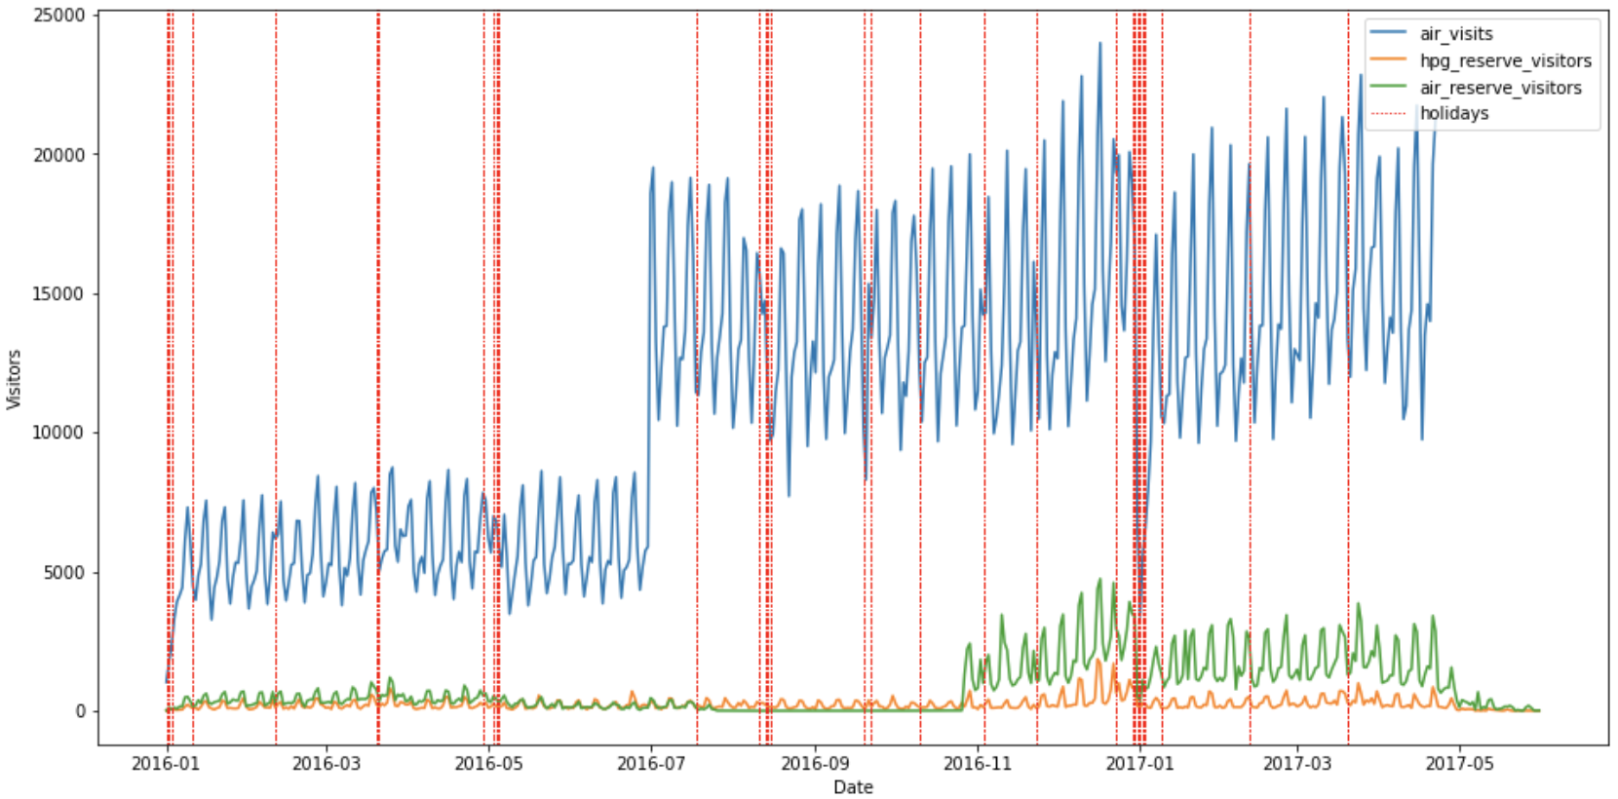
Holiday Effect
Pre and Post holiday are good markers for prediction

Slide 12
TIME SERIES APPROACH

Slide 13

Notes:
Auto regression models like ARIMA and SARIMA need data to be stationary.
They dont handle seasonality well and are sensitive to outliers and missing data.
Hence we decided to go with prophet as our forecasting tool.

Slide 14
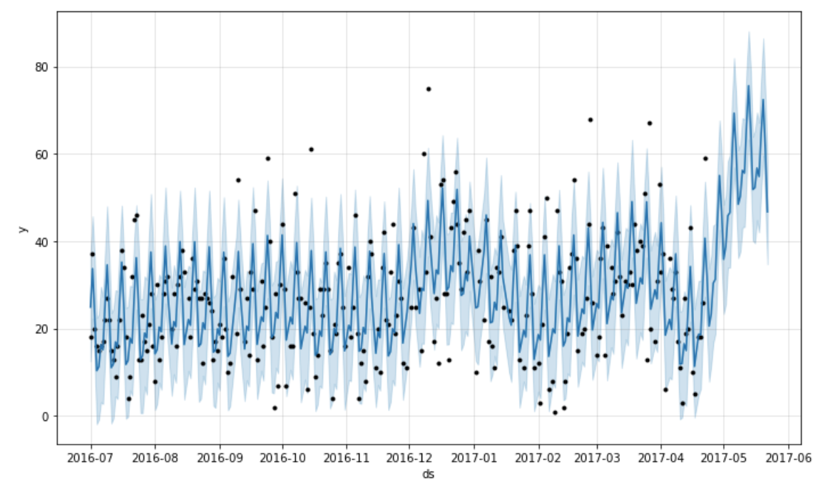
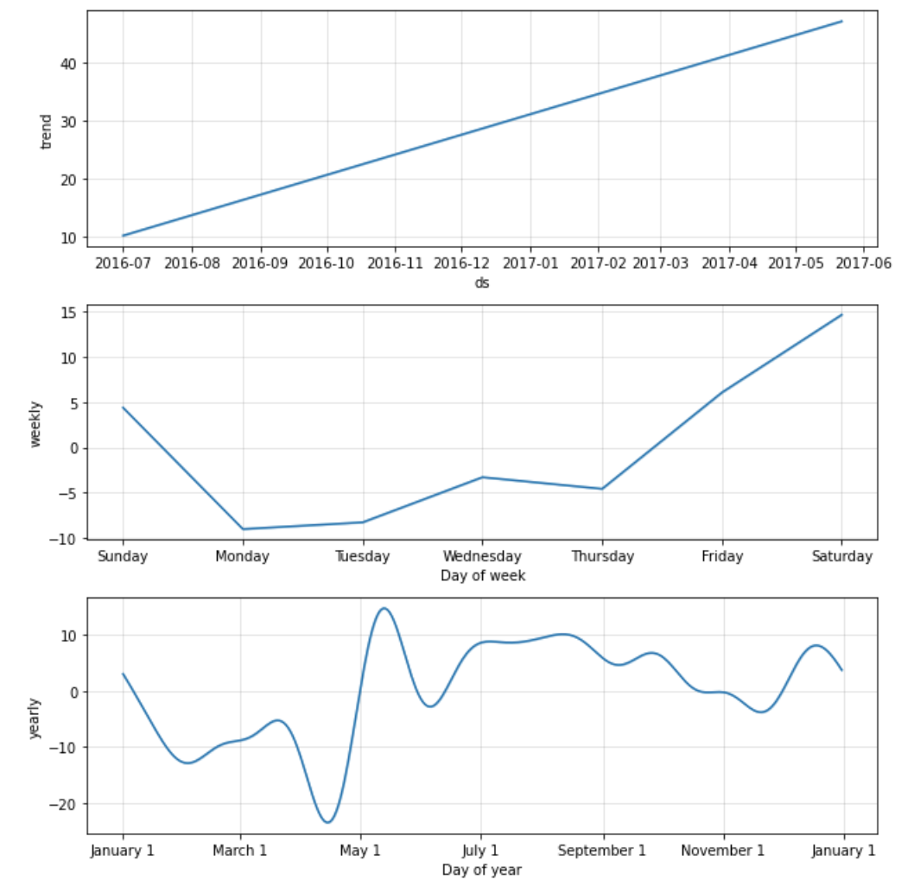
Prophet - Without Holidays and Weather
Notes:
Prophet is based on an additive model where non-linear trends are fit with yearly, weekly, and daily seasonality, plus holiday effects.
It works best with time series that have strong seasonal effects and several seasons of historical data.
Prophet is robust to missing data and shifts in the trend, and typically handles outliers well.
It can be observed that prophet learns to model the weekly seasonality really well.
Though the data is limited, it give a good approximation to yearly trend as well.

Slide 15
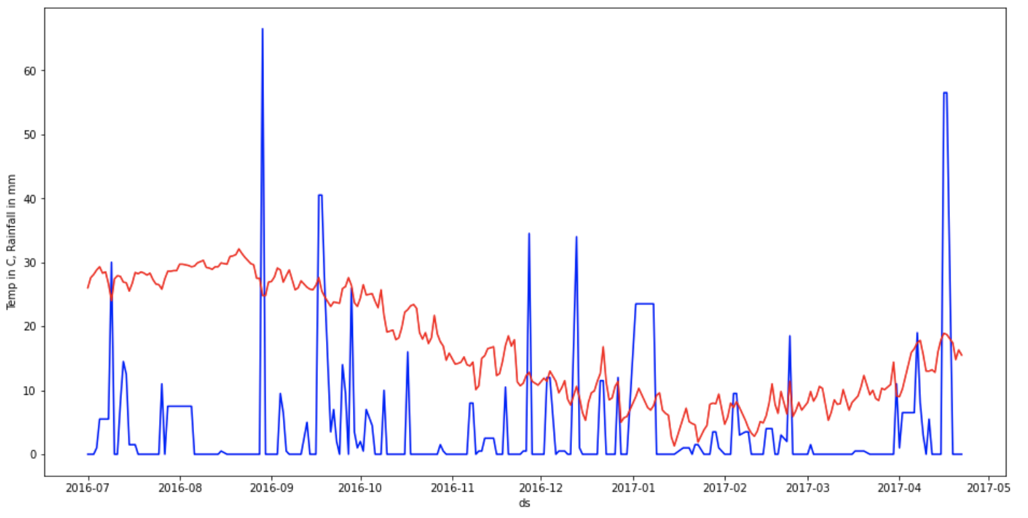
Merging external weather data
Filled missing values using global average

Slide 16
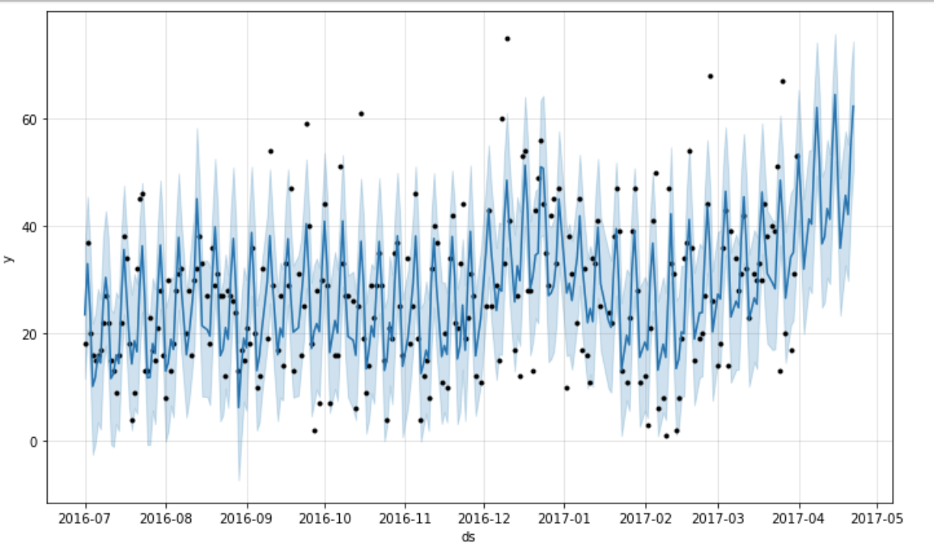
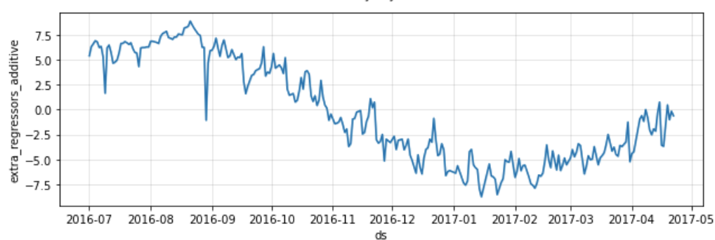
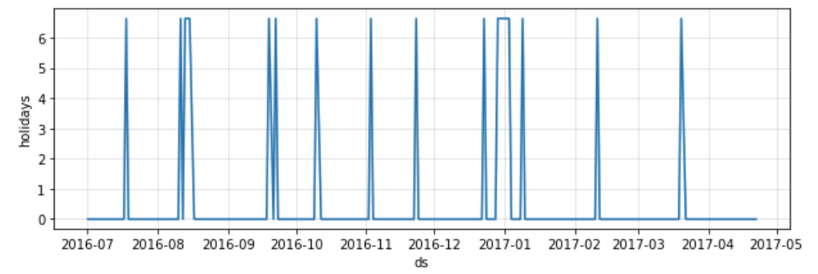
Prophet - With Holidays and Weather Regressors
Notes:
I would like to mention that like traditional models it doesn’t take into account the correlation between past values.
It is analogous to fourier transforms - linear decomposition.
However it is super easy to include recurring or one time outlier event to make the model more accurate.
Example : ad campaign explains the spike in user engagement and model can be tuned to learn the event for future instead of considering it as an outlier and smoothening it out,
In our case it will be a game day or exams for undergraduate students, etc
For this competition we are including external weather data and list of holidays in japan.
compare the additional regression curve with weather.

Slide 17
REGRESSION APPROACH

Slide 18
Feature Engineering
Hour Gap between visit time and reservation time
Date split into month,day of week,year
Visitor Stats as attributes
Weather Data Integration ( Temp & Precipitation )
Categorical One hot encodings
Distance from the weather station
Day of month (Salary spendings)
Pre & Post Holiday Flags

Slide 19
Feature Engineering
Pre and Post holiday are good markers for prediction

Slide 20
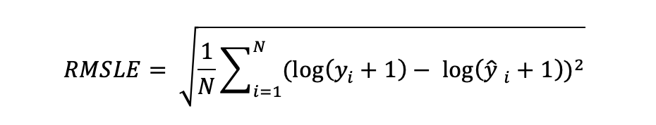
Evaluation Metric - Choice?
Mean Absolute Error
R squared Error
Root Mean Squared Error
Root Mean Square Log Error
RMSLE penalizes underpredictions more than overprediction. Useful in cases where underprediction is not acceptable!
Therefore RMSLE will be our choice of evaluation metric!

Slide 21
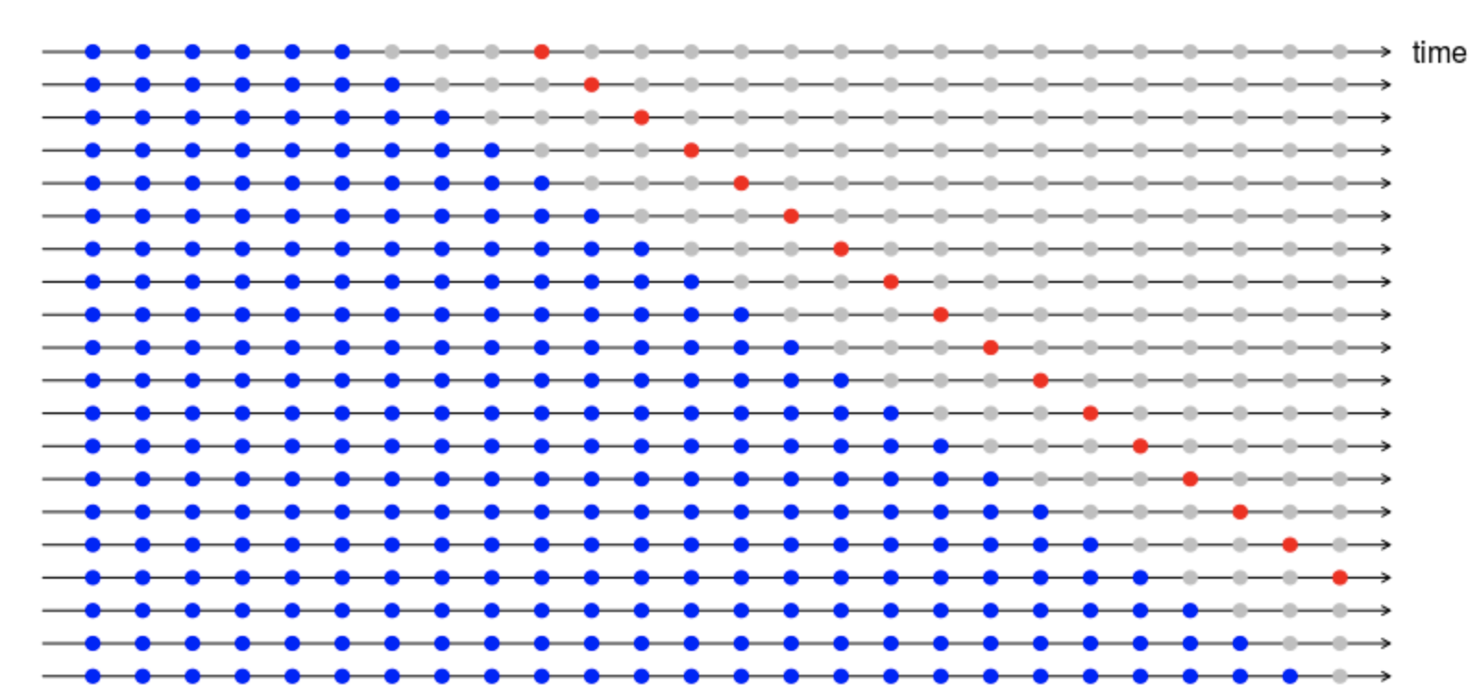
AdaBoost
XGBoost
Cross Validation
n_estimators = 1000
max_depth = 10
learning_rate = 0.01
n_estimators = 3500
max_depth = 5
min_samples_split = 200
min_samples_leaf = 50
learning_rate = 0.005
max_features = 9
subsample = 0.7
K Fold = 5
Average the predictions of each model
Gradual cross validation vs Random split

Slide 22
Model Performance
Model | RMSLE on cross vaildation data
Prophet without holidays and weather | 0.51563
Prophet with holidays and weather | 0.49831
Adaboost | 0.50567
XGboost | 0.47448

Slide 23
Current Work
Hyperparameter tuning
Explore CatBoost and LightBGM
Stacking XGBoost, CatBoost, LightBGM
Some more feature engineering
converting reservation information and weather in to categorical data to reduce counter noise
handling outlier visit numbers
grouping the restaurants according to their genre and locality.
Feature selection

Slide 24
References -
https://www.heraldtimesonline.com/story/news/local/2021/09/29/iu-bloomingtons-dining-halls-struggle-supply-staff-shortages/8417866002/
https://www.idsnews.com/article/2021/10/iu-dining-mismanagement-food-quality-issues-empty-promises
https://www.idsnews.com/article/2021/09/students-experience-long-wait-times-and-food-shortages-with-iu-dining
https://www.idsnews.com/article/2021/09/opinion-all-you-can-eat-dining-halls-hurt-students-more-than-they-help
https://csanjay.medium.com/recruit-restaurant-visitor-forecasting-a704cd5432c8
https://robjhyndman.com/files/cv4-1.png
https://www.kaggle.com/gvyshnya/gbm-cv-submission-lb-score-0-511

Slide 25
THANK YOU

